Slide 1
Changing the subject with simple formula
Expressions and formulae

Slide 2
How our teaching resources are designed for the classroom

Slide 3
I can apply an understanding of inverse operations to a simple formula in order to make a specific variable the subject.

Slide 4


The subject of an equation/a formula is a variable that is expressed in terms of other variables. It should have an exponent of 1 and a coefficient of 1.
For example, a is the subject of this formula
but, a² is not the subject of this formula

Slide 5

Changing the subject with simple formula
Identifying the subject of the formula
Changing the subject of simple formula

Slide 6
Identifying the subject of the formula
Rearranging equations and formula is a valuable skill in mathematics.
4 + 6 = 10
This is 10 expressed in terms of 4 and 6
4 = 10 − 6
What would 4 expressed in terms of 10 and 6 look like?
6 = 10 − 4
What would 6 expressed in terms of 10 and 4 look like?

Slide 7
Identifying the subject of the formula
We can generalise the rule for rearranging additive relationships.
If a + b = c then…
a = c − b
a expressed in terms of c and b
In this form a is the subject of the equation.
b = c − a
b expressed in terms of c and a
In this form b is the subject of the equation.

Slide 8
Identifying the subject of the formula
The subject of an equation/a formula is a variable that is expressed in terms of other variables. It should have an exponent of 1 and a coefficient of 1.
a = c − b
a expressed in terms of c and b
In this form a is the subject of the equation.
b = c − a
b expressed in terms of c and a
In this form b is the subject of the equation.

Slide 9
Identifying the subject of the formula
The subject of an equation/a formula is a variable that is expressed in terms of other variables. It should have an exponent of 1 and a coefficient of 1.
Solve y + 35 = 78
35 + y = 78
y = 78 − 35
35 = 78 − y
In this form y is the subject of the equation.
In the context of this equation we can immediately calculate the unknown because it is the subject.
y = 43

Slide 10
Identifying the subject of the formula
The generalisation for additive relationships.
a + b = c
b + a = c
a = c − b
b = c − a
In this form a is the subject of the equation.
In this form b is the subject of the equation.
So what is the subject of the original form?

Slide 11
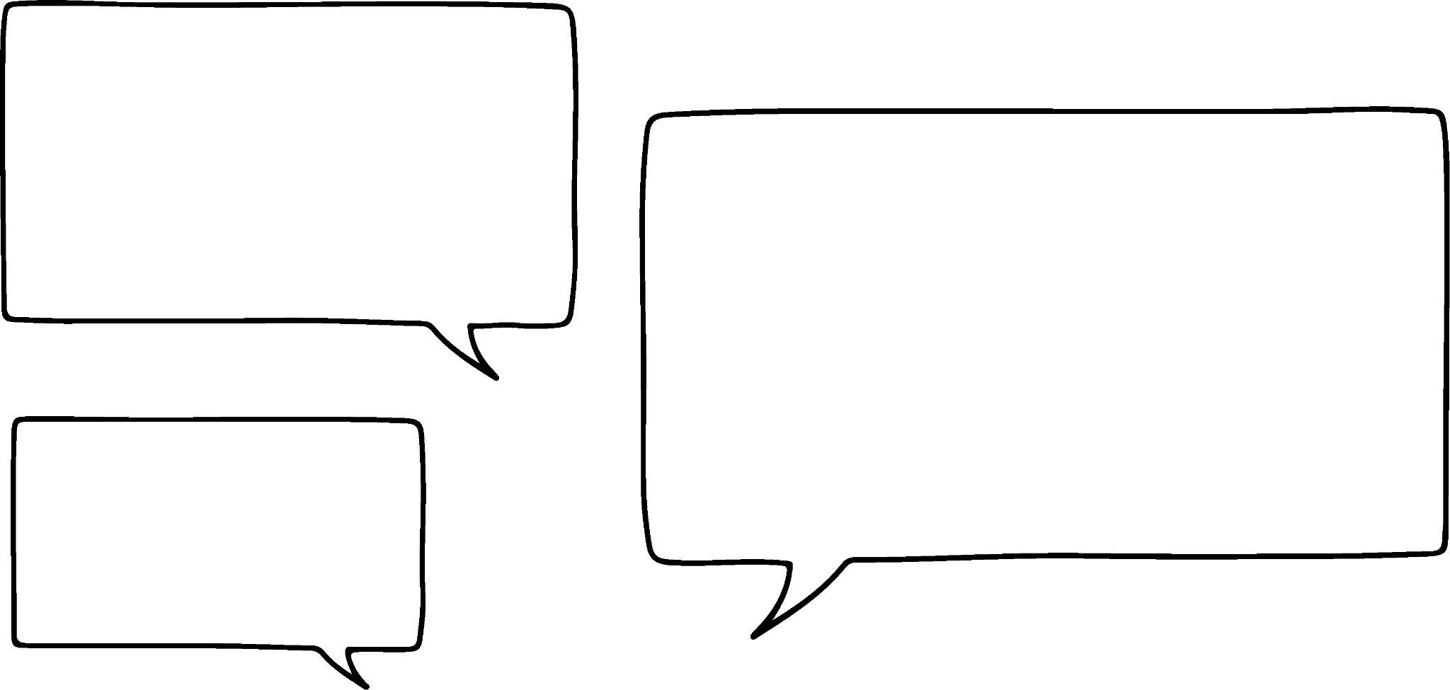

Identifying the subject of the formula
The generalisation for additive relationships.
a + b = c
I think a is the subject because it is the 1st thing on the LHS.
Do you agree?
Andeep
So what is the subject of the original form?

Slide 12

Identifying the subject of the formula
The generalisation for additive relationships.
a + b = c
I think a is the subject because it is the 1st thing on the LHS.
Look at the definition of subject again Andeep.
Andeep
The subject of an equation/a formula is a variable that is expressed in terms of other variables. It should have an exponent of 1 and a coefficient of 1
Sofia

Slide 13
Identifying the subject of the formula
The generalisation for additive relationships.
The subject must be c because this is c expressed in terms of other variables.
a + b = c
Well corrected Andeep! c is the subject.
The subject can be on the left or right hand side.
Andeep
The subject of an equation/a formula is a variable that is expressed in terms of other variables. It should have an exponent of 1 and a coefficient of 1
Sofia

Slide 14
Identifying the subject of the formula
a² + b² = c²
b² + a² = c²
I was learning about right-angle triangles recently and saw this formula.
a² = c² − b²
b² = c² − a²
So I can rearrange this relationship like this.
Yes. That’s right. You can rearrange this like you would any additive relationship.
Andeep
Sofia

Slide 15
Identifying the subject of the formula
a² + b² = c²
b² + a² = c²
So I can have c² as the subject.
a² = c² − b²
b² = c² − a²
Or I can make a² the subject. It depends what I want to work out.
Let’s check that definition of subject again Andeep.
Andeep
The subject of an equation/a formula is a variable that is expressed in terms of other variables. It should have an exponent of 1 and a coefficient of 1
Sofia

Slide 16
Identifying the subject of the formula
a² + b² = c²
b² + a² = c²
I see now! We can’t call a² the subject because it doesn’t have an exponent of 1
a² = c² − b²
b² = c² − a²
Well done. The subject should have an exponent of 1 and a coefficient of 1
Andeep
The subject of an equation/a formula is a variable that is expressed in terms of other variables. It should have an exponent of 1 and a coefficient of 1
Sofia

Slide 17


Identifying the subject of the formula
In which of these rearrangements of the equation x + y = z is y the subject?
x + y = z
x = z − y
y + x = z
y = z − x
The only rearrangement where y is expressed in terms of other variables.

Slide 18
Identifying the subject of the formula
In which of these rearrangements of the equation x + y = z is z the subject?
x + y = z
z is expressed in terms of other variables. The subject can be on the RHS of an equation or formula.
x = z − y
y + x = z
z is expressed in terms of other variables. The subject can be on the RHS of an equation or formula.
y = z − x

Slide 19
Identifying the subject of the formula
In the equation 5y² = x + 7 the subject is 5y²
We would need to continue rearranging until y was on its own.
5y² is not the subject because it does not have an exponent of 1 or coefficient of 1
5y² is the subject because it is expressed in terms of the other variables.

Slide 20
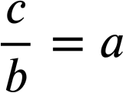
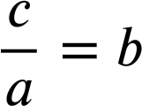
Identifying the subject of the formula
We can also identify the subject in multiplicative relationships.
If 4 × 8 = 32 then…
32 ÷ 8 = 4
8 × 4 = 32
32 ÷ 4 = 8
A generalisation for multiplicative relationships.
a × b = c
b × a = c

Slide 21
Identifying the subject of the formula
We can also identify the subject in multiplicative relationships.
a × b = c
In this form c is the subject of the equation.
In this form a is the subject of the equation.
b × a = c
In this form c is the subject of the equation.
In this form b is the subject of the equation.

Slide 22
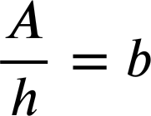
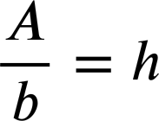
Identifying the subject of the formula
In each rearrangement of this formula identify the variable which is the subject.
A = b × h
h
A is the subject.
b
b is the subject.
A = h × b
A is the subject.
h is the subject.

Slide 23


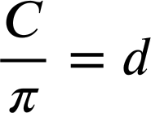
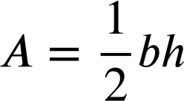
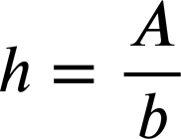
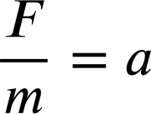


Identifying the subject of the formula
1) Identify the subject in each of these formula/equations.
a)
b)
c)
d)
e)
f)
g)
h)

Slide 24

Identifying the subject of the formula
2) Aisha is solving the equation 85 − 3x = 17
The equation can be rearranged in these forms:
85 − 3x = 17
85 − 17 = 3x
85 = 17 + 3x
85 = 3x + 17
The form 85 − 17 = 3x is the best rearrangement because 3x is the subject.
Write a sentence explaining what is wrong with Aisha’s statement.

Slide 25
Identifying the subject of the formula
1) Identify the subject in each of these formula/equations.
a)
b)
c)
d)
e)
f)
g)
h)

Slide 26
Identifying the subject of the formula
2) Aisha is solving the equation 85 − 3x = 17
The equation can be rearranged in these forms:
85 − 3x = 17
85 − 17 = 3x
85 = 17 + 3x
85 = 3x + 17
The form 85 − 17 = 3x is the best rearrangement because 3x is the subject.
You might have written:
Whilst 85 − 17 = 3x is the best form from which to solve we can not call 3x the subject because the coefficient is 3 not 1

Slide 27
Changing the subject with simple formula
Identifying the subject of the formula
Changing the subject of simple formula

Slide 28
Changing the subject of simple formula
We can rearrange equations and formula using inverse operations.
x + 12 = 37
What is the inverse of +12?
The expressions on each side remain equal because we have performed the same operation to both sides.
x + 12 + (−12) = 37 + (−12)
x = 37 − 12
x is now the subject of the equation.
x = 25
From this position we have the solution.

Slide 29
Changing the subject of simple formula
We can rearrange equations and formula using inverse operations.
x − 2.7 = 8.1
What is the inverse of −2.7?
The expressions on each side remain equal because we have performed the same operation to both sides.
x − 2.7 + 2.7 = 8.1 + 2.7
x = 8.1 + 2.7
x is now the subject of the equation.
From this position we have the solution.
x = 10.8

Slide 30
Changing the subject of simple formula
Sometimes we will need to use multiple operations.
17 − y = 4
17 − y + y = 4 + y
17 = 4 + y
17 + (−4) = 4 + y + (−4)
17 − 4 = y
y is now the subject of the equation.
13 = y
The solution.

Slide 31
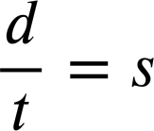
Changing the subject of simple formula
We can rearrange multiplicative relationships using the same principles.
d = s × t
The inverse of × t
Same operation both sides to maintain equality.
d ÷ t = s × t ÷ t
s is now the subject of the formula.
We started with d expressed in terms of s and t and ended up with a different perspective; s expressed in terms of d and t

Slide 32
Changing the subject of simple formula
The command you will typically see in algebra is:
Make s the subject of the formula.
d = s × t
d is currently the subject.
d ÷ t = s × t ÷ t
Inverse operation to isolate s
By rearranging we made s the subject of the formula.

Slide 33
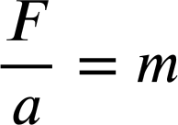
Changing the subject of simple formula
Make x the subject:
x + y = 10
x + y + (−y) = 10 + (−y)
x = 10 − y
Make m the subject:
F = m × a
F ÷ a = m × a ÷ a

Slide 34
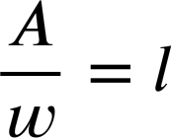
Changing the subject of simple formula
Make x the subject:
Make y the subject:
x + y = 10
x + y = 8
x + y + (−y) = 10 + (−y)
x + y + (−x) = 8 + (−x)
x = 10 − y
y = 8 − x
Make m the subject:
Make l the subject:
F = m × a
A = l × w
F ÷ a = m × a ÷ a
A ÷ w = l × w ÷ w

Slide 35
Changing the subject of simple formula
1) In each equation/formula change the subject as instructed.
a) Make x the subject.
b) Make l the subject.
x − 2.7 = 8.1
P = 3l
c) Make y the subject.
d) Make w the subject.
17 − y = 4
A = l × w
e) Make u the subject.
f) Make r the subject.
v = u + at
C = 2πr

Slide 36
Changing the subject of simple formula
2) Rearrange this formula as instructed.
F − E + V = 2
a) Make F the subject.
b) Make V the subject.
c) Make E the subject.

Slide 37
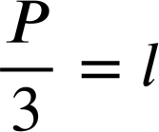
Changing the subject of simple formula
1) In each equation/formula change the subject as instructed.
a) Make x the subject.
b) Make l the subject.
x − 2.7 = 8.1
P = 3l
x − 2.7 + 2.7 = 8.1 + 2.7
P ÷ 3 = 3× l ÷ 3
x = 8.1 + 2.7
x = 10.8

Slide 38
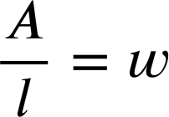
Changing the subject of simple formula
1) In each equation/formula change the subject as instructed.
c) Make y the subject.
d) Make w the subject.
17 − y = 4
A = l × w
17 − y + y = 4 + y
A ÷ l = l × w ÷ l
17 = 4 + y
17 − 4 = 4 + y − 4
17 − 4 = y
13 = y

Slide 39
Changing the subject of simple formula
1) In each equation/formula change the subject as instructed.
c) Make y the subject.
After lots of practice you will be able to instantly see the family of rearrangements when you see an equation in this form.
17 − y = 4
17 − y + y = 4 + y
17 = 4 + y
17 − y = 4
4 + y = 17
17 − 4 = 4 + y − 4
17 − 4 = y
y + 4 = 17
17 − 4 = y
Notice the 4 and the y have swapped positions.
13 = y

Slide 40
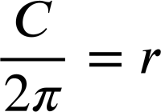
Changing the subject of simple formula
1) In each equation/formula change the subject as instructed.
e) Make u the subject.
f) Make r the subject.
v = u + at
C = 2πr
v − at = u + at − at
C ÷ 2π = 2πr ÷ 2π
v − at = u

Slide 41
Changing the subject of simple formula
2) Rearrange this formula as instructed.
F − E + V = 2
a) Make F the subject.
F − E + V = 2
F − E + V + E − V = 2 + E − V
F = 2 + E − V
b) Make V the subject.
F − E + V = 2
F − E + V + E − F = 2 + E − F
V = 2 + E − F
c) Make E the subject.

Slide 42
Changing the subject of simple formula
2) Rearrange this formula as instructed.
F − E + V = 2
a) Make F the subject.
F = 2 + E − V
b) Make V the subject.
V = 2 + E − F
c) Make E the subject.
F − E + V = 2
F − E + V + E = 2 + E
F + V = 2 + E
F + V − 2 = 2 + E − 2
F + V − 2 = E

Slide 43
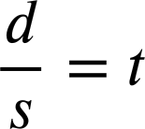
Changing the subject with simple formula
We can apply inverse operations to simple formula in order to make a specific variable the subject.
For example, in this formula d is the subject.
d = s × t
The inverse of ×s will make t the subject.
d ÷ s = s × t ÷ s
There will be times when this will be really useful.

Slide 44

© Oak National Academy 2024.
Produced in partnership with Mathematics in Education and Industry.
Licensed on the Open Government Licence v3.0, except where otherwise stated. See Oak terms and conditions.

